Slide 1
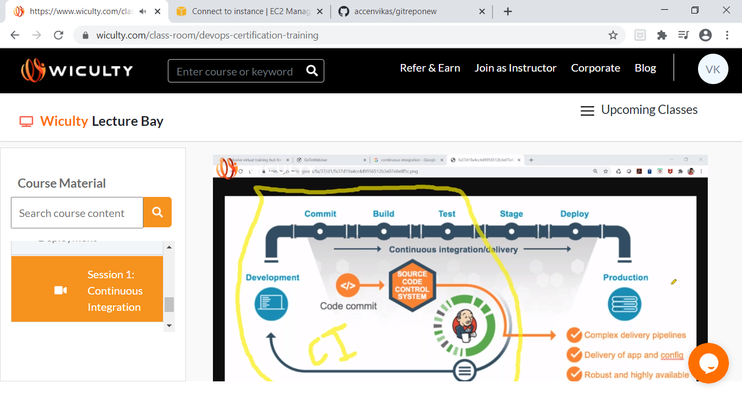
Notes:
Jenkins is a community-developed open-source automation server.

Slide 2
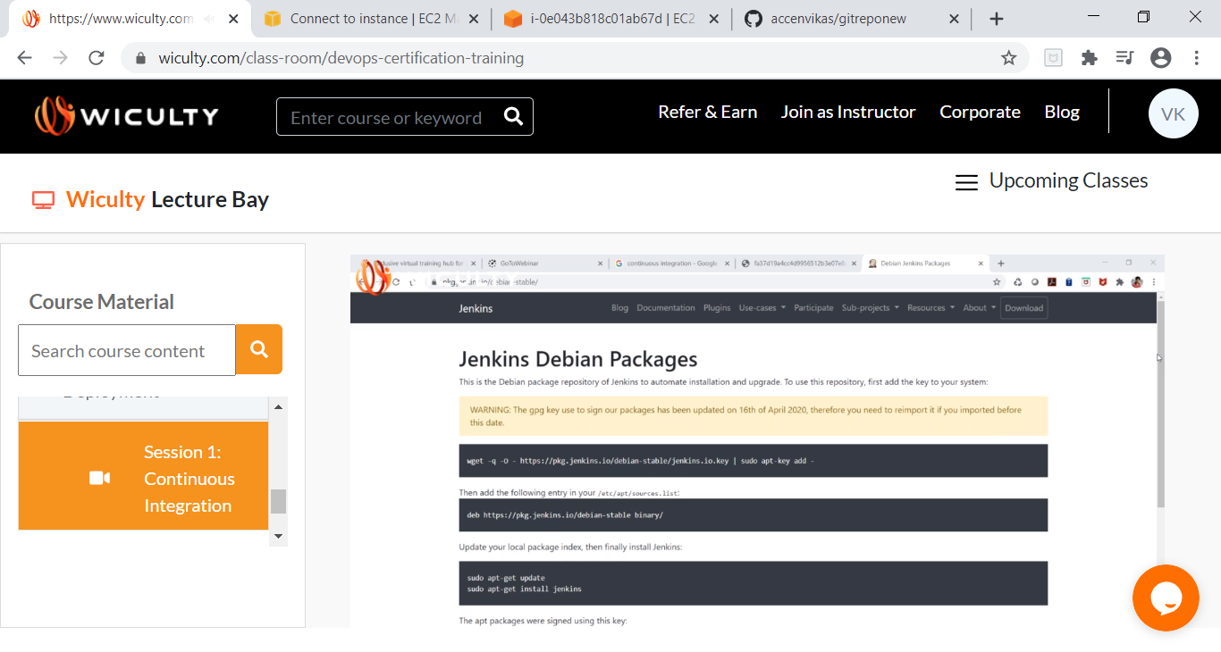
Notes:
https://www.jenkins.io/
Download stable LTS – 12 weeks

Slide 3
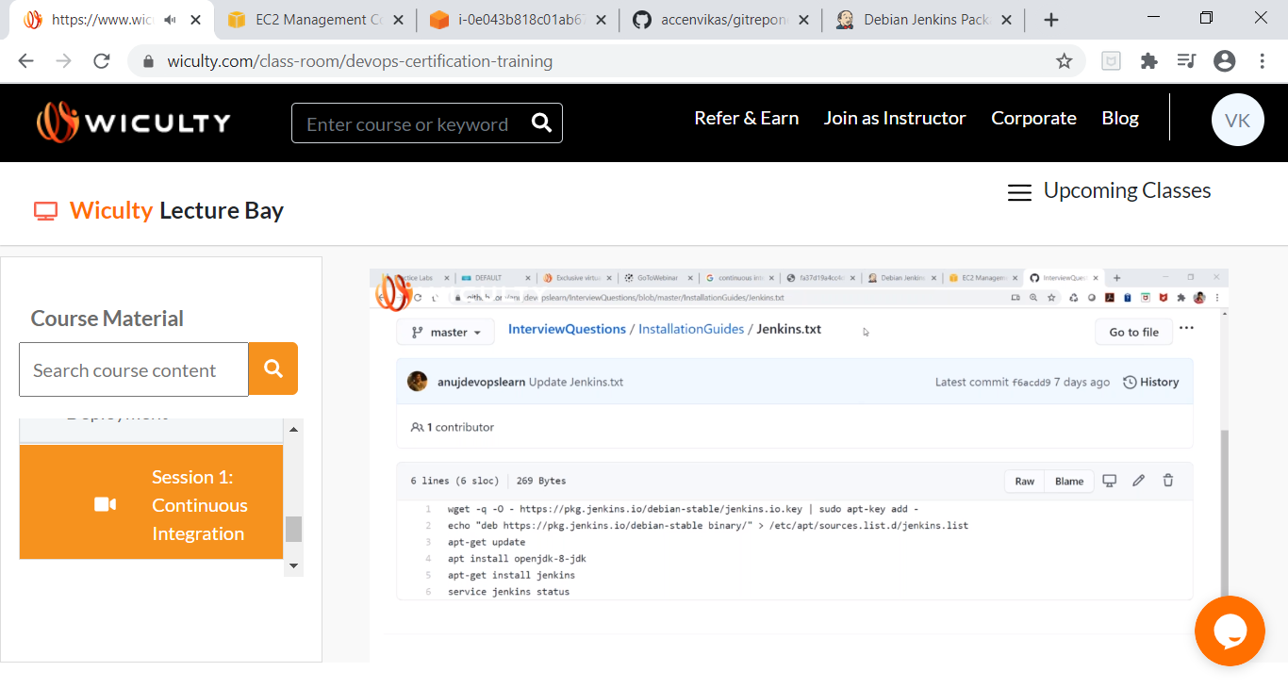
Notes:
https://pkg.jenkins.io/debian-stable/ (install jenkins in vm and below command is updated in such a way that execution happens smoothly)
wget -q -O - https://pkg.jenkins.io/debian-stable/jenkins.io.key | sudo apt-key add -
echo "deb https://pkg.jenkins.io/debian-stable binary/" > /etc/apt/sources.list.d/jenkins.list
apt-get update
apt install openjdk-8-jdk
apt-get install jenkins
service jenkins status

Slide 4
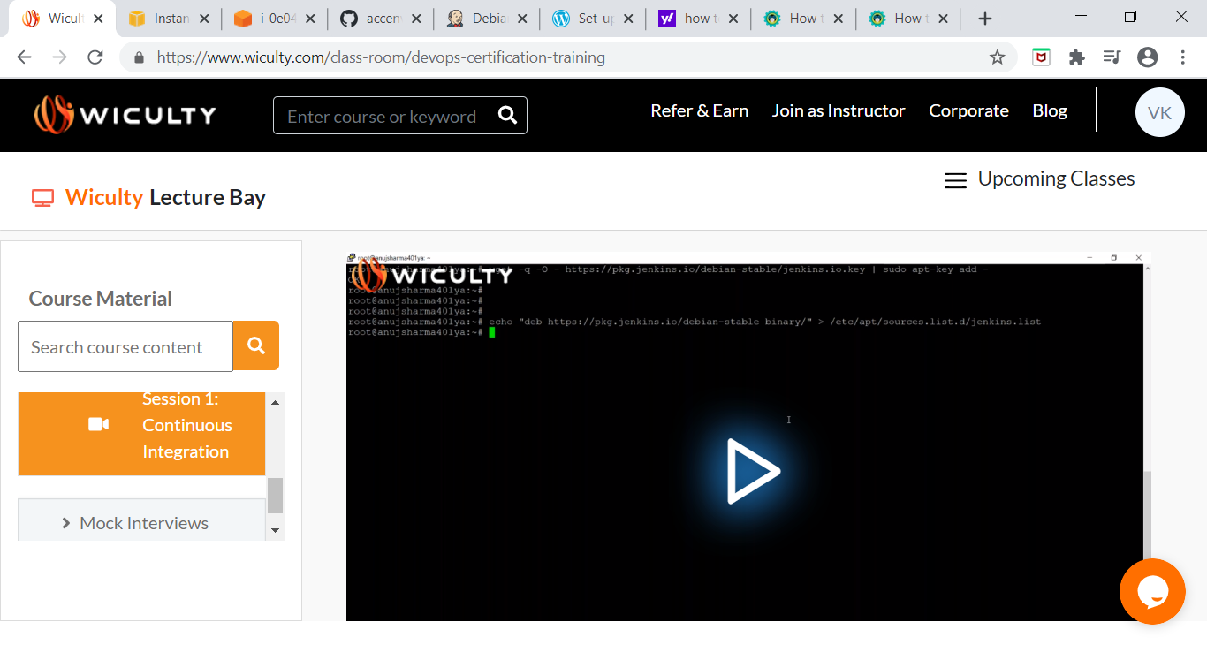

Slide 5
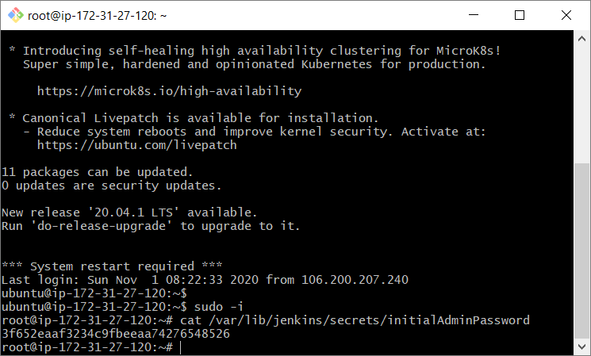
Notes:
cat /var/lib/jenkins/secrets/initialAdminPassword (to get password - 3f652eaaf3234c9fbeeaa74276548526)

Slide 6
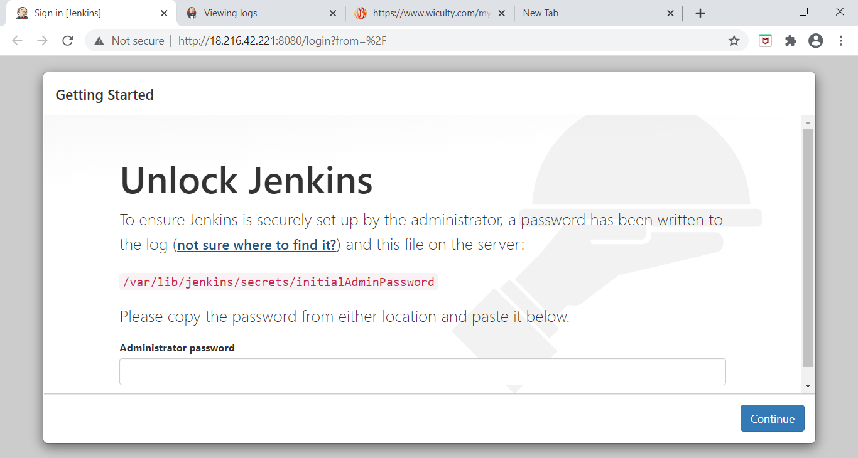

Slide 7
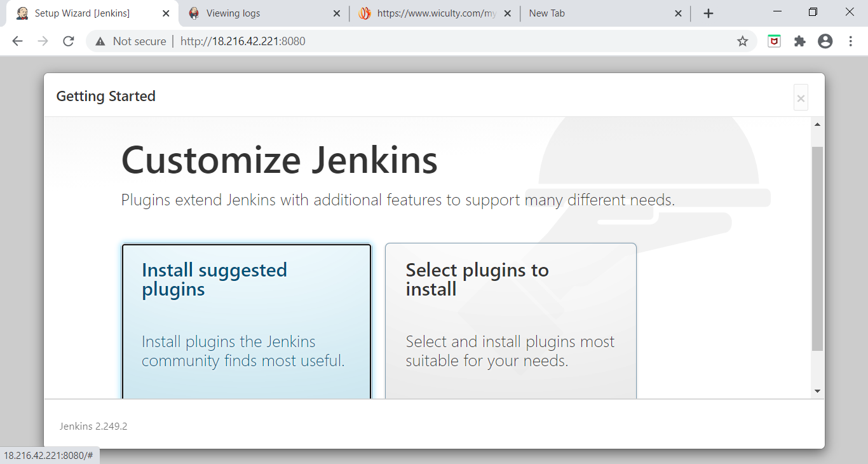
Notes:
click on suggested plugins

Slide 8
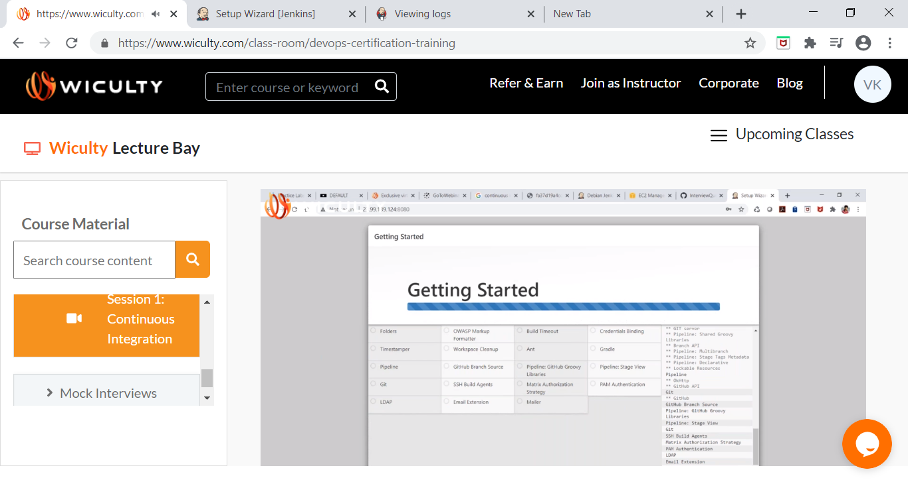

Slide 9
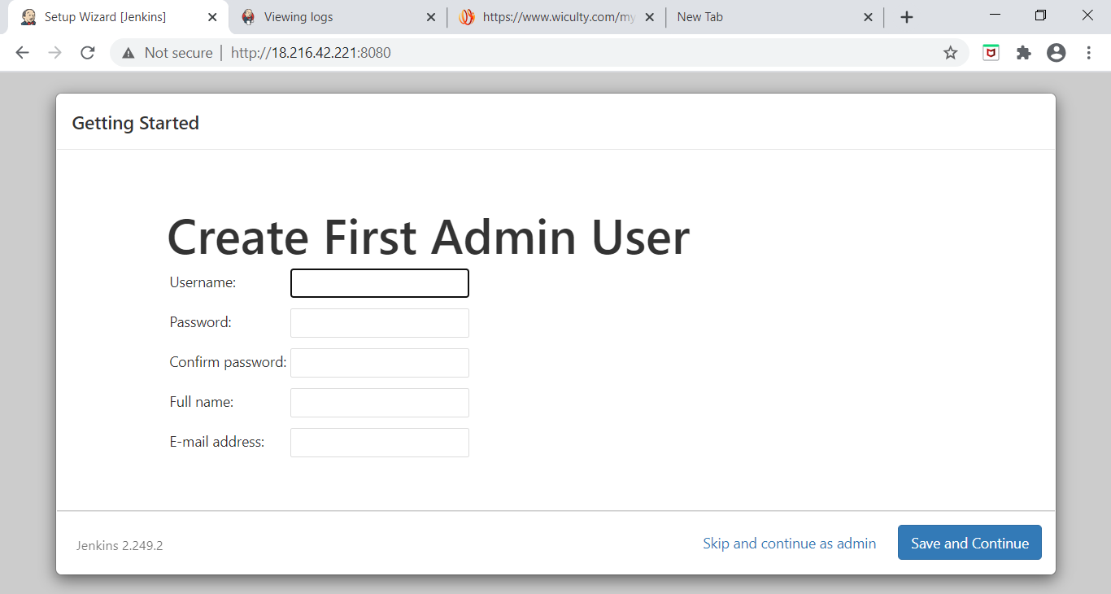

Slide 10
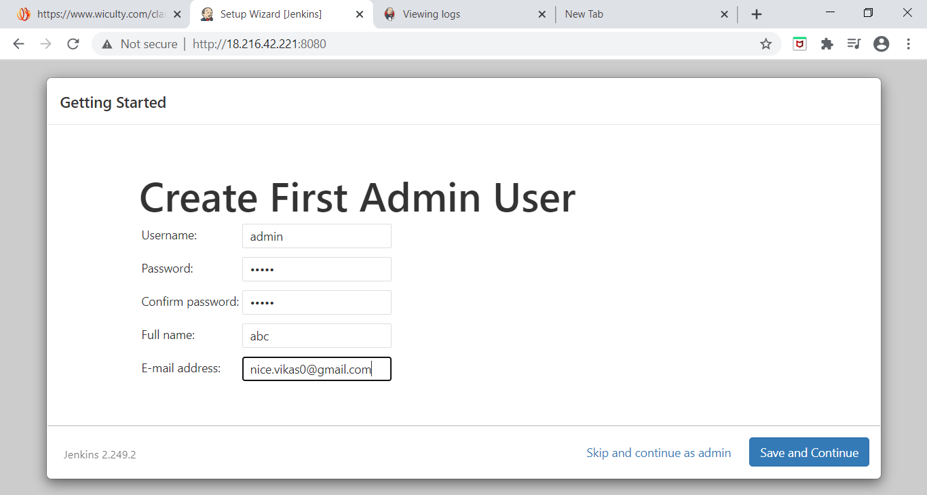

Slide 11
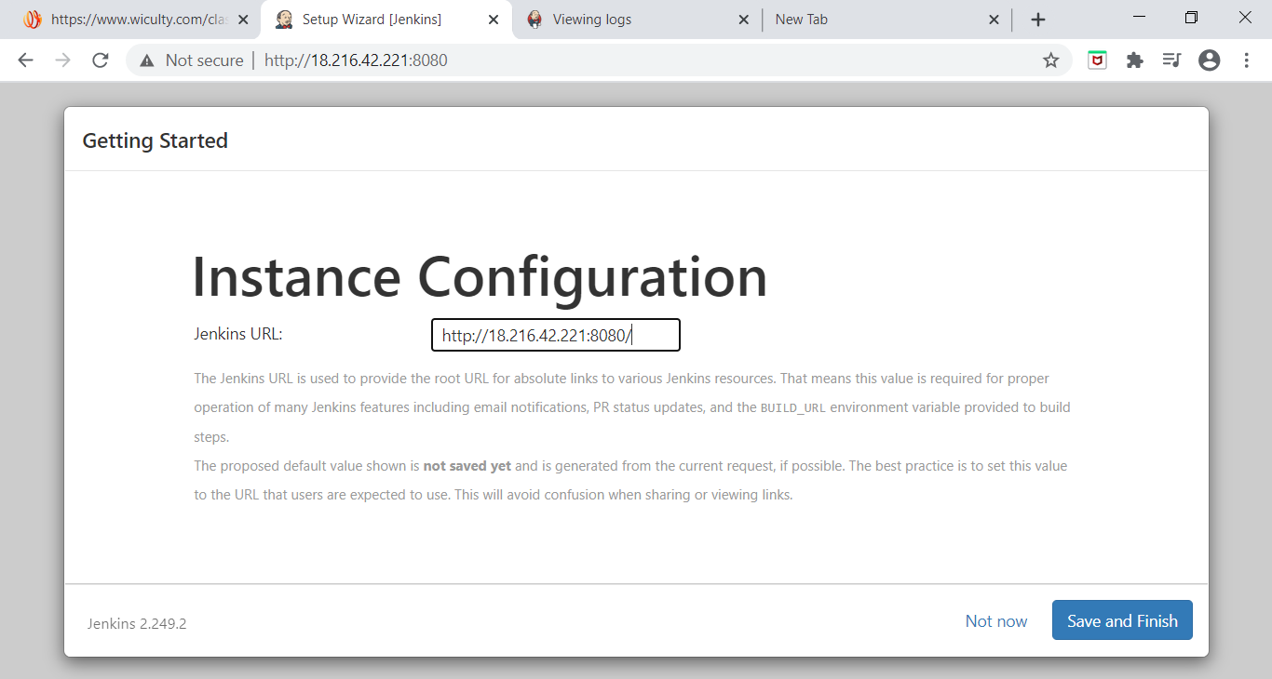
Notes:
http://18.216.42.221:8080/

Slide 12
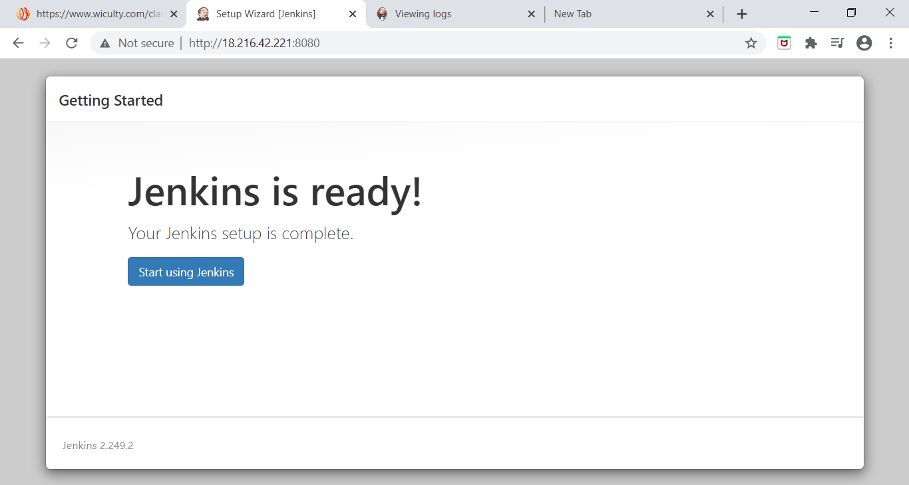

Slide 13
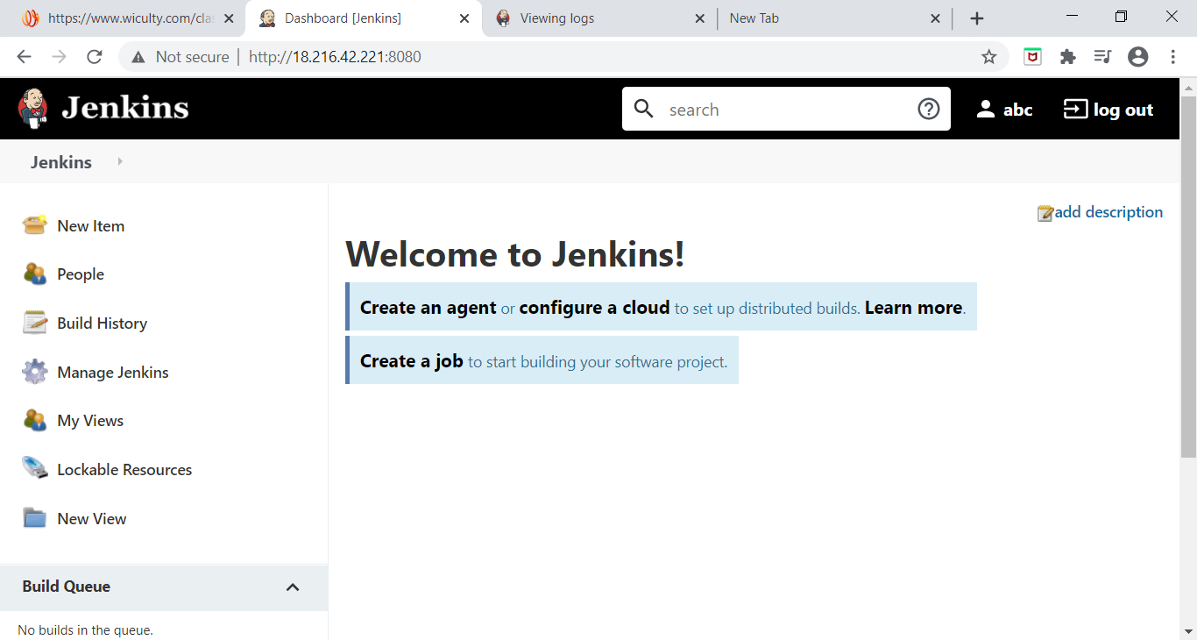
Notes:
Jenkins version: 2.249.2

